Slide 1


Indian Premier League 2015-2024 Presentation

Slide 2

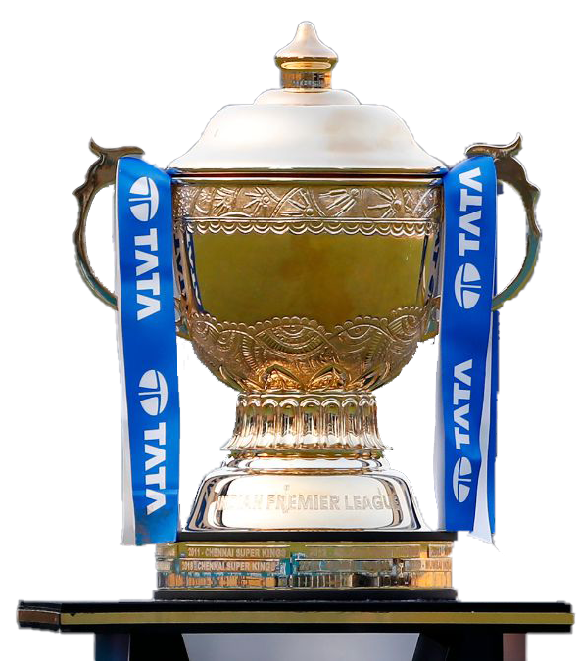
Introduction
About the dataset:
In this IPL dataset, there are 21 columns in total, but for my analysis, I mainly used around 10 to 12 columns, with 638 rows of data. The dataset originally covered the years from 2008 to 2024, but I filtered it to focus on the seasons from 2015 to 2024.
Tools used:
"I have used Pivot Tables and Pivot Charts in Excel to analyze the data.
Objectives:
"The main objective of my project is to analyze decision-making patterns and evaluate player performance throughout different IPL seasons.

Slide 3










Team Playing
Chennai Super Kings
Gujarat Titans
Delhi Capitals
Kolkata Knight Riders
Lucknow Super Giants
Punjab Kings
Mumbai Indians
Rajasthan Royals
Sunrisers Hyderabad
Royal Challengers Bengaluru

Slide 4
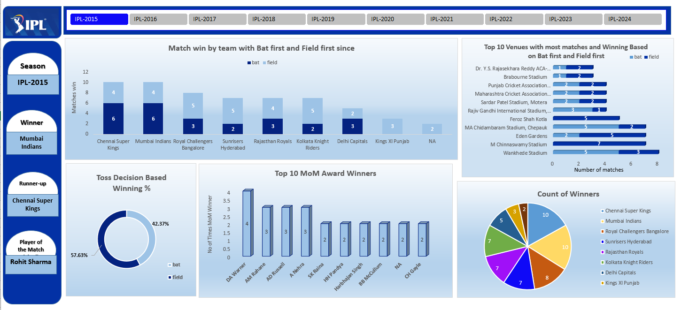
DASHBOARD OVERVIEW

Slide 5
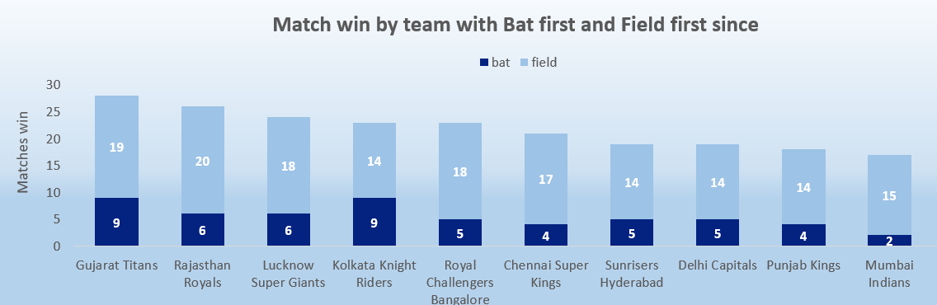
Problem Statement 1
How do IPL teams perform when batting first versus chasing from 2022 to 2024 ?

Slide 6
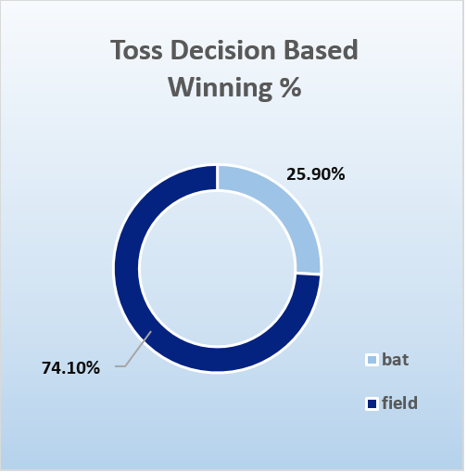
Problem Statement 2
Does winning the toss provide a significant advantage in IPL matches from 2015-2024?
It plays a significant role
Batting first 25.90%
Fielding first 74.10%

Slide 7
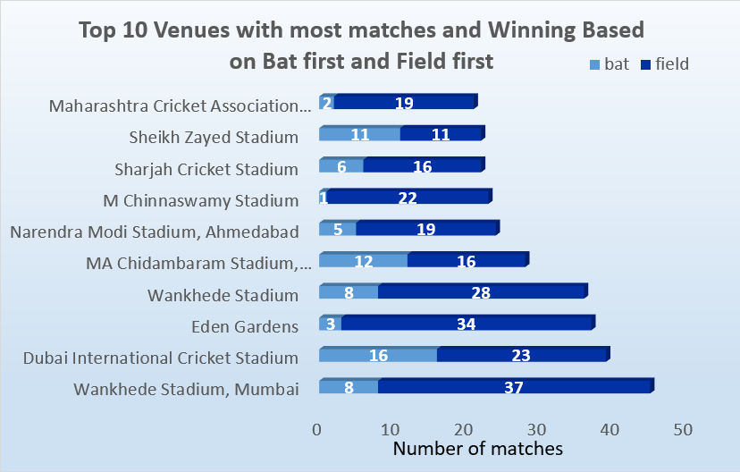
Problem Statement 3
Which venues favor batting first versus chasing throughout the season

Slide 8
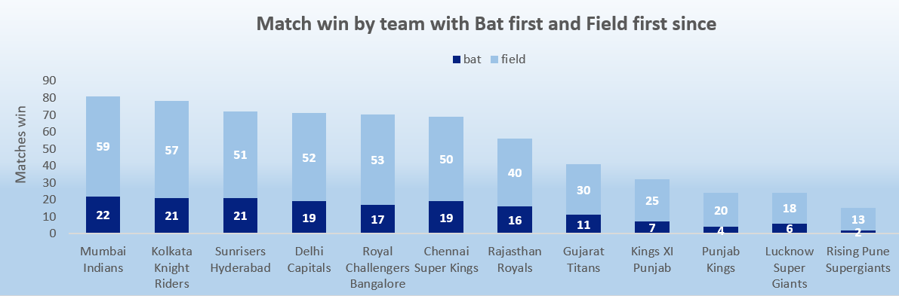
Problem Statement 4
Which teams have the highest success rate in defending a total from 2015 to 2024?

Slide 9
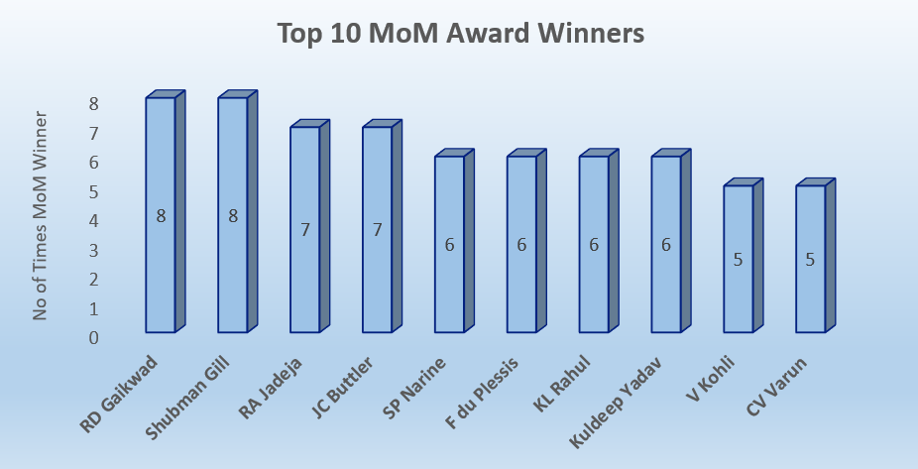
Problem Statement 5
Who are the top 10 players that consistently deliver match-winning performances from 2020 to 2024

Slide 10
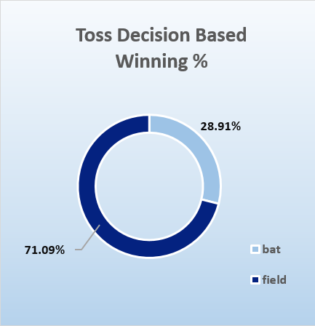
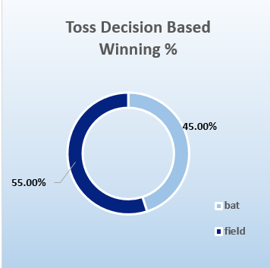
Problem Statement 6
Does the impact of toss results change over different seasons (2020–2024)?
(2020–2024)
(2020)

Slide 11
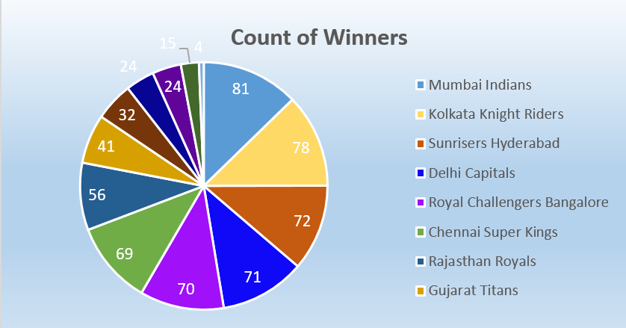
Problem Statement 7
Which teams dominate the IPL by consistently winning matches between 2015–2024

Slide 12
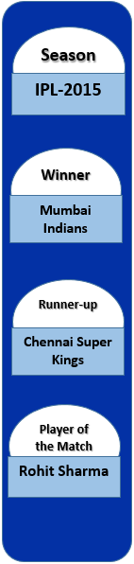
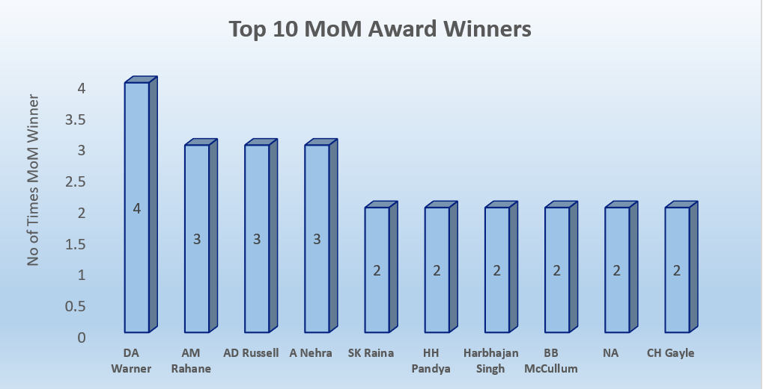
Problem Statement 8
In season 2015 who was the winner and runner-up team and top 5 MoM winners

Slide 13
Conclusion
Venue Effect: Certain venues clearly favor batting first, while others favor chasing, showing strong influence of pitch and conditions.
Star Performers: A small group of players repeatedly win Man of the Match, proving their consistent match-winning impact.
Team Dominance: A few teams (like MI, CSK) dominate the winners’ list, but newer teams are also challenging strongly in recent years.
Toss Impact: Winning the toss gives only a moderate advantage—teams’ decision-making after the toss matters more.
Trends Over Time: IPL strategies have shifted over the years, with chasing becoming more successful in recent seasons.

Slide 14
Thank You!

